Slide 1
Topic name – Data Mining in social media computing
Name of the students- Anjali Rajole (48)
Megha shinde(57)
Priyanaka vidhate (66)
Hrutika sawant(54)

Slide 2
content
Abstract
Introduction
Literature review
Methodology
Study
Analysis
Examples
Conclusion
reference

Slide 3
Abstract
in this case study report, we explore the use of data mining techniques in social media analysis. We discuss the process of collecting and analyzing data from social media platforms and how this information can be used to gain valuable insights into consumer behavior, sentiment analysis
The rise of online social media is providing a wealth of social network data. Data mining techniques provide researchers and practitioners the tools needed to analyze large, complex, and frequently changing social media data. .

Slide 4
introduction
Social media has become an important platform for communication and information sharing, with millions of users worldwide generating vast amounts of data every day. This data can provide valuable insights into consumer behavior, sentiment analysis, and other areas of interest. However, extracting meaningful insights from this data requires advanced techniques such as data mining.
The structure of the social media data is unorganized and is displayed in different forms such as: text, voice, images, and videos. Moreover, the social media provides an enormous amount of continuous real time data that makes traditional statistical methods unsuitable to analyze this massive data. Therefore, the data mining techniques can play an important role in overcoming this problem.

Slide 5
Literature review
In recent years, social media have experienced tremendous growth in their user base. For example, there are more than one billion members belonging to the Facebook network (Facebook 2013), while Twitter now has more than 280 million monthly active users (GlobalWeb- Index 2013).
Recent studies and surveys have revealed an emerging need to continuously collect, monitor, analyze, summarize, and visualize relevant information from social interactions and user generated content in various domains such as business, public administration, politics, or consumer decision-making. These activities, however, are considered difficult tasks due to the large number of different social media platforms as well as the vast amount, dynamics, and complexity of social media data. More specifically, social media communication generates an enriched and dynamic set of data and meta data, which have not been treated systematically in the data mining literature

Slide 6
Sr No | Author Name | Paper Title | Technique | Year
1 | Sanjeev Dhawan, Kulvinder Singh, Vandana Khanchi | Critical Analysis of Social Networks with Web Data Mining | Web Mining Techniques | 2014
2 | Esmaeil Fakhimi gheshlagh mohammad beig | Data Mining Techniques for Web Mining: A Review | Web Mining | 2015
3 | Mukta Patkar, Pooja Pawar Mony Singh, Ashwini | New way for Semi Supervised Learning Based on Data Mining for Product Reviews | Semi Supervised Approach | 2016

Slide 7
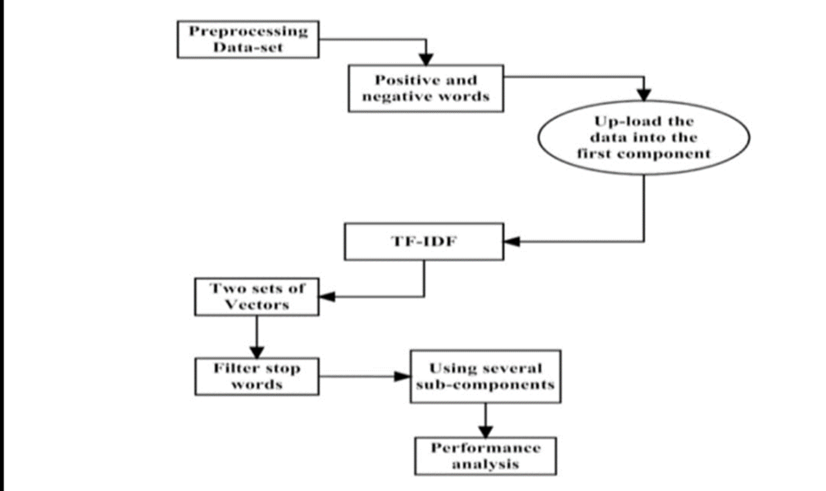
methodology
Social data first needs to be collected and processed. This is data that is publicly available, which may include age, race, geographic location, job profession, schools you’ve attended, languages you speak, friends and connections, networks you belong to, and more
Figure no 2. Data mining architecture from social media

Slide 8
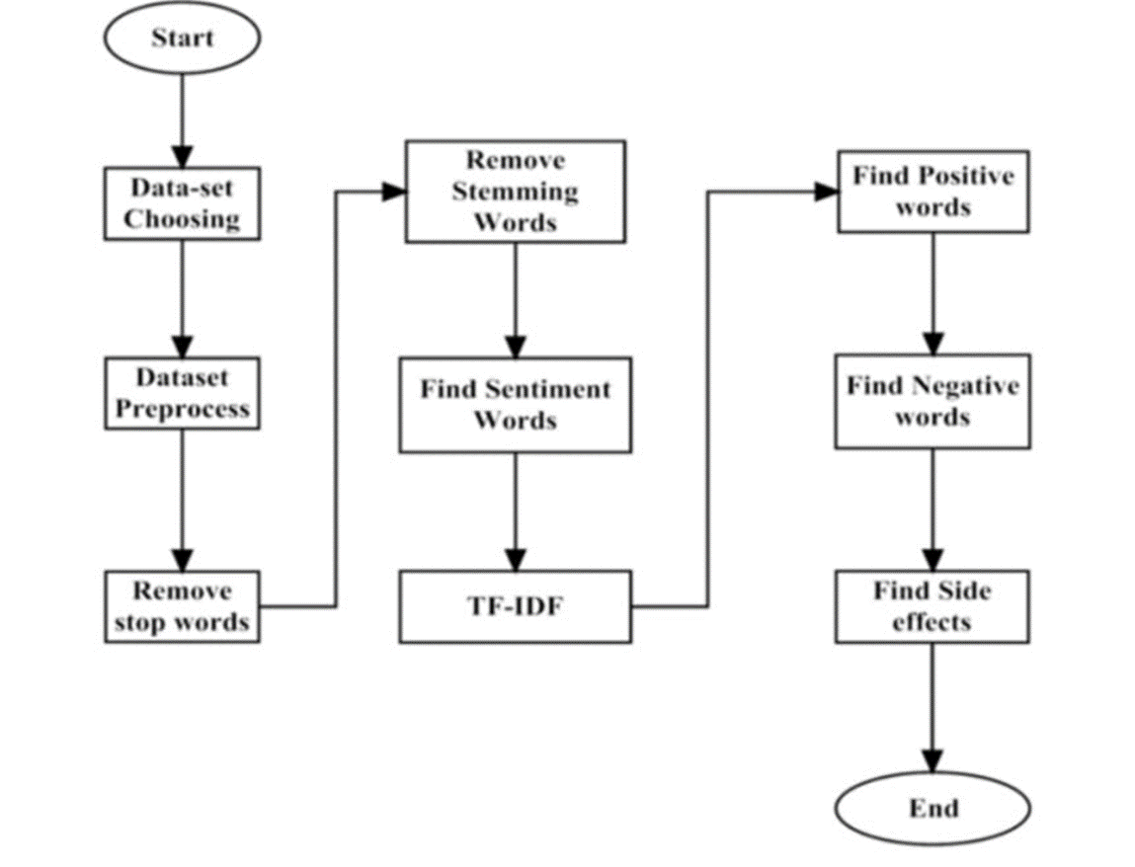
FIGURE no1.flow chart of proposed methodology

Slide 9
study
The study of data mining in social media involves the analysis of the vast amounts of data generated by users on these platforms. This data includes user profiles, posts, comments, likes, shares, and other forms of user-generated content
Data mining techniques such as machine learning, natural language processing, and network analysis can be used to extract valuable insights from this data. For example, machine learning algorithms can be used to classify social media users based on their demographics, interests, and behaviors. Natural language processing techniques can be used to analyze the sentiment of social media posts, and to identify topics and trends in user-generated content.

Slide 10
Network analysis can be used to study the relationships between users on social media platforms, and to identify influential users or groups. This can be useful for businesses and organizations looking to target specific audiences, or for researchers studying the spread of information or opinions on social media.
the study of data mining in social media has both practical and ethical implications. On the one hand, it can provide valuable insights into consumer behavior, market trends, and public opinion. On the other hand, it raises concerns about privacy, security, and the potential for bias and discrimination in data mining algorithms.
To ensure that data mining in social media is used responsibly and ethically, it is important to establish clear guidelines and safeguards for the collection, storage, and analysis of social media data. This includes obtaining informed consent from users, protecting their personal information, and avoiding the use of data mining algorithms that perpetuate bias and discrimination.

Slide 11
analysis
As per the "Global Digital Report," the total number of active users on social media platforms worldwide in 2019 is 2.41 billion and increases up to 9 % year-on-year. With the universal use of Social media platforms via the internet, a huge amount of data is accessible. Social media platforms include many fields of study, such as sociology, business, psychology, entertainment, politics, news, and other cultural aspects of societies. Applying data mining to social media can provide exciting views on human behavior and human interaction. Data mining can be used in combination with social media to understand user's opinions about a subject, identifying a group of individuals among the masses of a population, to study group modifications over time, find influential people, or even suggest a product or activity to an individual.

Slide 12
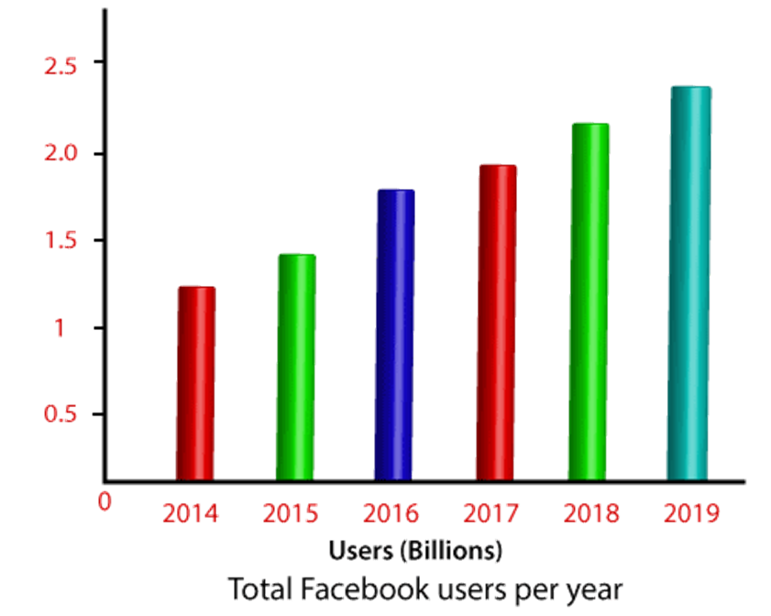
For example, The presidential election during 2008 marked an unprecedented use of social media platforms in the United States. Social media platforms, including Facebook, YouTube played a vital role in raising funds and getting candidate's messages to voters. Researcher's extracted blog data to demonstrate correlations between the amount of social media platform used by candidates and the winner of the 2008 presidential campaign.

Slide 13
example
Here is an example of how data mining can be used in social media:
Example: A company wants to launch a new product and is interested in understanding the preferences and opinions of its target audience. They decide to analyze social media data to gather inside.
Data Collection: The company uses web scraping tools to collect data from various social media platforms, such as Twitter, Facebook, and Instagram. They collect posts, comments, and other user-generated content related to their product. Data Cleaning: The collected data is then pre-processed to remove irrelevant information, such as duplicate posts, spam messages, and unrelated content

Slide 14
Topic Modeling: The company uses topic modeling algorithms to identify the most frequently discussed topics related to their product. This allows them to understand the key features that users are interested in.
Cluster Analysis: Based on the sentiment analysis and topic modeling results, the company performs cluster analysis to segment users based on their interests and preferences. This helps them create targeted marketing campaigns for each segment.
Predictive Analytics: Finally, the company uses predictive analytics techniques to forecast the demand for their product and estimate the potential revenue. This helps them make data-driven decisions about their product launch strategy.

Slide 15
conclusion
Data mining in social media has become an important tool for businesses, organizations, and researchers to extract useful information from the vast amounts of data available on these platforms. By analyzing social media data, it is possible to gain insights into consumer behavior, market trends, and public opinion, among other things.
However, there are also concerns about the ethics of data mining in social media. Some worry that the personal data of users may be misused, and that data mining algorithms may perpetuate bias and discrimination.
It is therefore important to use data mining in social media responsibly and ethically, and to ensure that the privacy and security of users are protected. With proper safeguards in place, data mining in social media can be a valuable tool for understanding human behavior and improving our ability to make data-driven decisions.

Slide 16
references
Sankar K. Pal, Varun Talwar, Pabitra Mitra, “Web Mining in Soft Computing Framework:Relevance, State of the Art and Future Directions”, IEEE TRANSACTIONS ON NEURAL NETWORKS, VOL. 13, NO. 5, SEPTEMBER 2002.
Tomoyuki NANNO, Toshiaki FUJIKI, “Automatically Collecting, Monitoring, and Mining Japanese Weblogs”, WWW2004, May 17–22, 2004, New York, New York, USA.ACM1-58113-912-8/04/0005.
Ralph Gross, Alessandro AcquistiH. John Heinz III, “Information Revelation and Privacy in Online Social Networks (The Facebook case)”, Pre-proceedings version. ACM Workshop on Privacy in the Electronic Society (WPES), 2005.
Huan Liu and Lei Yu, “Toward Integrating Feature Selection Algorithms for Classification and Clustering”,IEEE Transactions on Knowledge and Data Engineering Volume 17 Issue 4,April 2005.
Andrea Esuli_ and Fabrizio Sebastiani†, “SENTIWORDNET: A Publicly Available Lexical Resource for Opinion Mining”, Proceedings of the 5th Conference on Language Resources and Evaluation, 2006.
Marcelo Maia, Jussara Almeida, Virgílio Almeida, “Identifyi

Slide 17
Thank you!

